Slide 1
Lecture 8
Sept. 17th ,2019
Exam 1---Will return by Friday.
Lab 2 report due---On or before Tuesday, Sept. 24th outside my office door-- 10 am. (Forgot that Sept. 23 is Assessment day—no class.)
Lab quiz/practical tomorrow
Where were we…..

Slide 2
Terminology
Anueploidy---gain or loss of 1 or more chromosomes, but not a complete set (result of non-disjunction).
2 common types
  Trisomy (2n +1)= number of chromosomes in the cell
  Monosomy (2n-1) = number of chromosomes in the cell

Slide 3
Rare cases of aneuploidy with full-term development
(Normal human [46, XX ]or [46, XY])
Down syndrome (Trisomy 21)
  Designation (47, +21)
  Patau syndrome (Trisomy 13)
  47, +13
  Edwards syndrome (trisomy 18)
  Turner syndrome (monosomy X)
  45, X
  http://www.turnersyndromefoundation.org
Physical resemblance, physical and mental developmental delays, heart malformation
Both show severe physical malformations, survive 3-4 months
Physically female, shorter, webbed neck, sometimes mental delays/malformations
Notes:
3

Slide 4
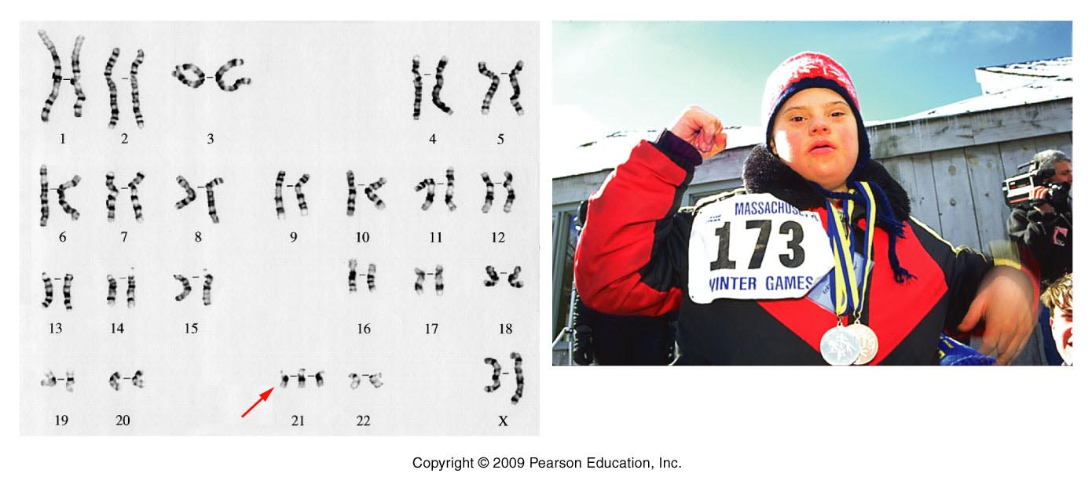
Figure 8.4
Notes:
4
Figure 8-4 The karyotype and a photograph of a child with Down syndrome. In the karyotype, three members of the G-group chromosome 21 are present, creating the 47,21+ condition.

Slide 5
Also---It’s important to understand that aneuploidy can occur in select somatic cells with little or serious effect. (as opposed to germline aneuplody which affects every cell).
  But….A hallmark of cancer cells is highly abnormal chromosomes—extra, missing, or rearranged chromosomes…which alter genes associated with cell cycle regualtion.

Slide 6
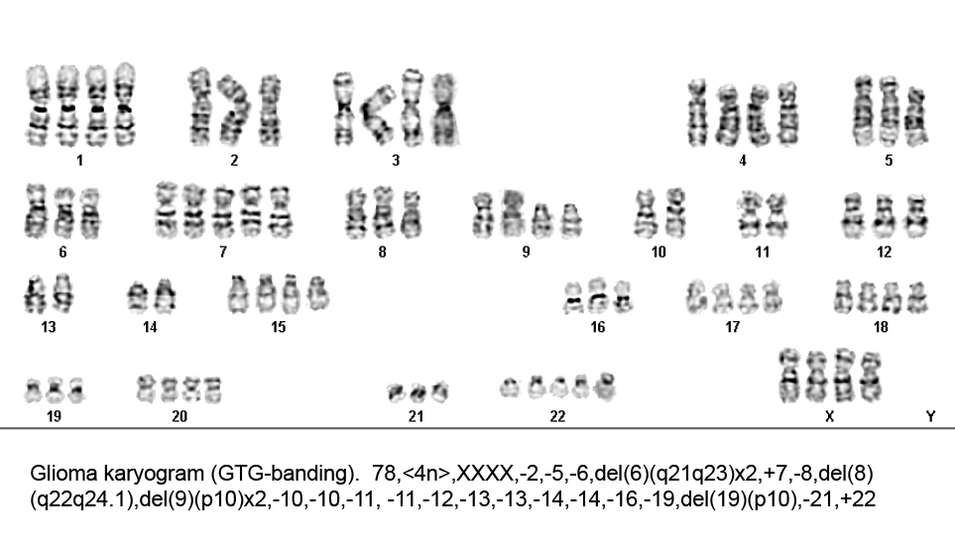
Extreme aneuploidy in brain tumor cells.

Slide 7
A second example of abnormal number of chromosomes is called:
Euploidy
  Having extra complete sets of chromosomes
  (if more than the normal amount=polyploidy)
  2n (normal for somatic cells) =diploid
  3n=triploid
  4n=tetraploid
  *common in some tissues of plants, but not in many animal species (some lizards, amphibians, fish)
Notes:
7

Slide 8
Why is the previous karyotype considered aneuploidy and not euploidy?

Slide 9
How can euploidy happen?
Replication of chromosomes, without cell division.
Failure of all chromosomes to segregate during meiosis---creating 2n gametes. Followed by fertilization with normal gametes.
  Forms triploid zygote.
Notes:
9

Slide 10
Final concept related to DNA in the cell (Chapter 9 section 9.2)
We have studied distribution of nuclear DNA (nDNA) in mitosis and meiosis.
**Cells also store DNA in 2 types of organelles
  Mitochondria (in all types of eukaryotic organisms)
  Chloroplasts (in photosynthetic organisms)
  Why? How did it get there? Endosymbiotic Theory
Notes:
10

Slide 11
Endosymbiotic Theory
Mitochondria and chloroplasts arose from free living bacteria-like organisms (prokaryotes)
Engulfed by primitive eukaryotic cells and retained because of mutually beneficial characteristics. (New ways of making energy/protection from predators).
Scientific evidence? Mitochondria and chloroplasts retain many characteristics of prokaryotes. (similar membranes, shape, circular DNA, asexual reproduction, prokaryotic biochemistry)
Notes:
11

Slide 12
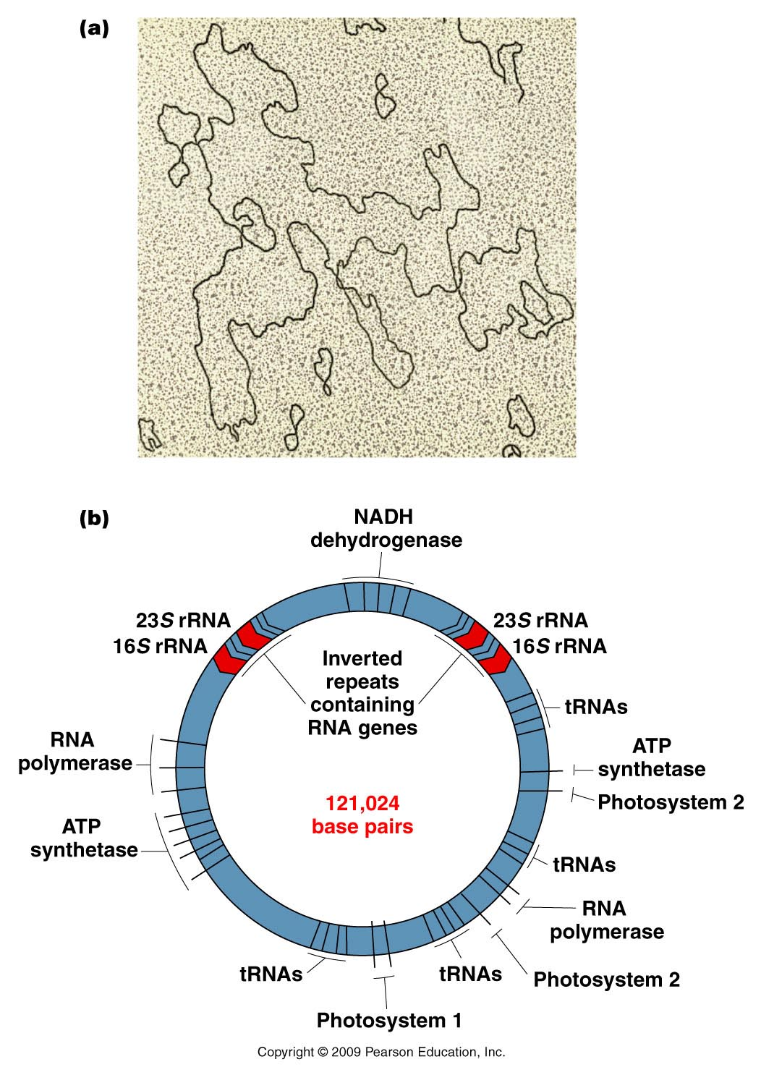
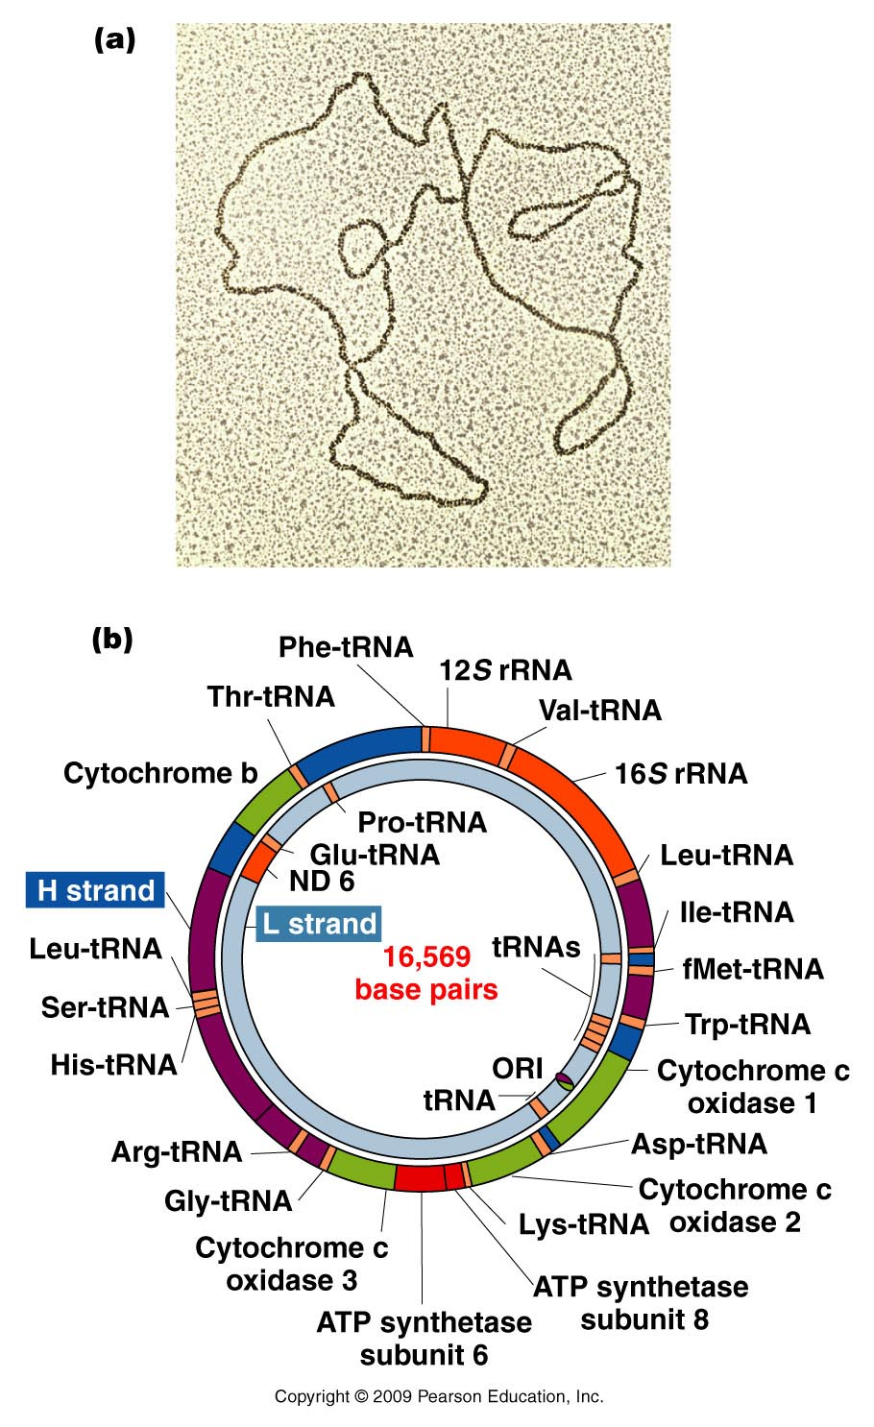
Circular genomes of mitochondria and chloroplasts
(similar to circular chromosomes of bacteria)
Figure 9.6
Notes:
12
Figure 9-6 Examples of chloroplast DNA. (a) Electron micrograph of chloroplast DNA derived from lettuce. (b) Diagram illustrating the arrangement of many of the genes encoded by cpDNA of the moss, Marchantia polymorpha. Photosytems 1 and 2 are groups of genes with photosynthetic functions.

Slide 13
What does mtDNA encode?
The circular DNA molecule in each mitochondrion encodes proteins that are needed for mitochondrion function.
What happens in mitochondria? Aerobic metabolism? Electron transport? ATP synthesis? REVIEW THESE!

Slide 14
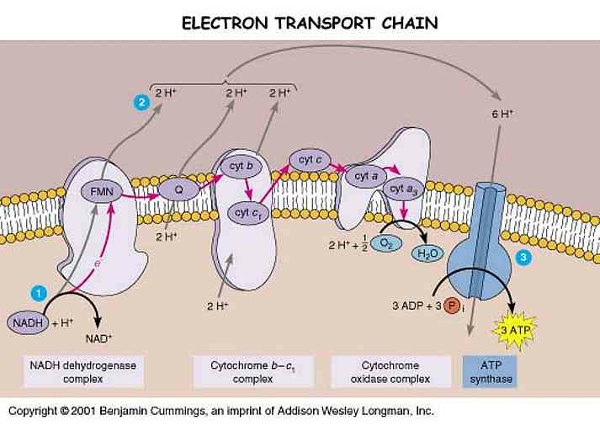

Slide 15
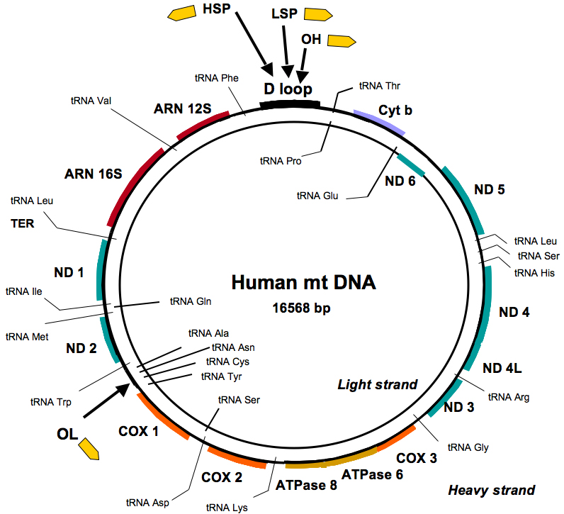
Look at gene names…

Slide 16
mtDNA vs. nDNA (nuclear DNA)
Recall the DNA in our nucleus came from our mother and father in egg and sperm. (you should be experts on this!) Our nuclear genes—are really what control our “personal genetics”. The genes of our nucleus dictate how tall we become, our hair color, our nose shape…everything we think of as inherited traits…

Slide 17
mtDNA houses genes that encode proteins needed in the mitochondria, for energy production.

Slide 18
Unlike nuclear genes, mitochondrial DNA is all from our mothers
Recall, the egg provides all the cytoplasm for the zygote/embryo so the mitochondria come from the egg.
mtDNA is a powerful tool for tracing ancestry through females.
Using mt DNA, all living humans have been shown to have a common female ancestor, who lived in Africa
Notes:
18

Slide 19
http://en.wikipedia.org/wiki/Mitochondrial_Eve

Slide 20
Mitochondria are of medical interest because of their fairly recent link to diseases---Known as mitochondrial disease.
http://www.umdf.org/site/c.8qKOJ0MvF7LUG/b.7934627/k.3711/What_is_Mitochondrial_Disease.htm

Slide 21
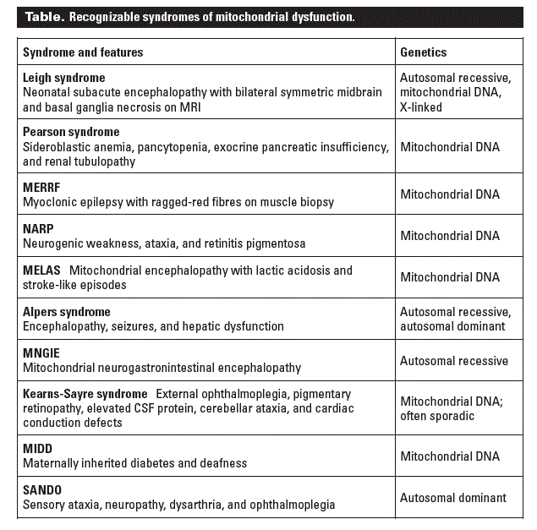

Slide 22
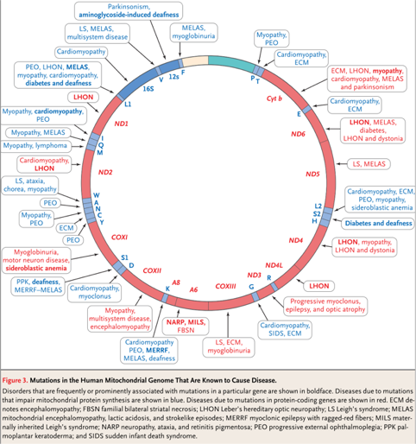
A mtDNA map showing mutations associated with mt disease

Slide 23
Recent news related to mitochondria!
An approach to avoiding mitochondrial disease was approved spring 2015 in the UK.
http://www.bbc.com/news/health-31069173
View this! Think about it!

Slide 24
More recently:
https://www.newscientist.com/article/2107219-exclusive-worlds-first-baby-born-with-new-3-parent-technique/

Slide 25
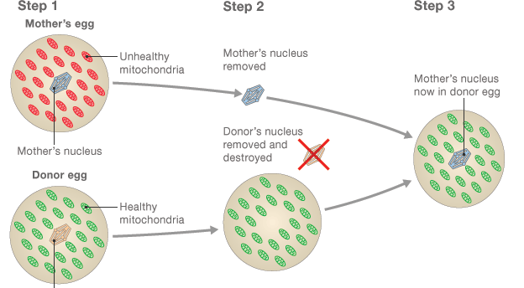
One method of avoiding these diseases

Slide 26
The “repaired” egg contains the nuclear DNA of the intended mother. It can be fertilized in vitro with sperm from the intended father.
The term “3-person baby” is ridiculous as a baby conceived in this way would by 99.9+% derived from the genetic material of the parents. ~ 0.1 % of the DNA would be mtDNA, which does not program development, or contribute to characteristics of the baby.

Slide 27
Yet..the US has not approved the procedure
But the general public may fail to really understand the true nature of the science behind many genetic applications. (Recall GMOs, in Europe)

Slide 28
Begin Chapter 3
Mendelian Genetics
Gregor Mendel—First to correctly describe how observable biological traits are passed from parents to offspring
  Mendelian genetics/transmission genetics/classical genetics
  1866 published data from experiments with the garden pea plant( Pisum sativum )

Slide 29
Mendel lived in the second half of the 1800s... Do you think Mendel was the first to notice aspects of genetics? Were people even controlling genetics?
  If not…explain.

Slide 30
Without knowledge of chromosomes or DNA…
Mendel described the process of meiosis:
  2n (germ cell) n (gamete)
  And….the genetics behind...
  Sexual reproduction:
  egg (n) + sperm (n) zygote (2n)
  Offspring

Slide 31
Mendel’s success was the result of several factors
A. Choice of organism
B. Experimental design
  Easy to grow, short life span, can produce many offspring from one mating.
  Mendel was a botanist—observed plants for long periods of time
  Can control breeding
    P. sativum---normally self-fertilizes (has both male and female gametes)
    Can cross-fertilize /hybridize
Experiments utilized true-breeding plants (showed consistent traits from generation to generation )
Kept experiments “simple”—tracking one or a few traits at a time in a breeding experiment
Kept accurate, quantitative records—noting consistent ratios in offspring

Slide 32
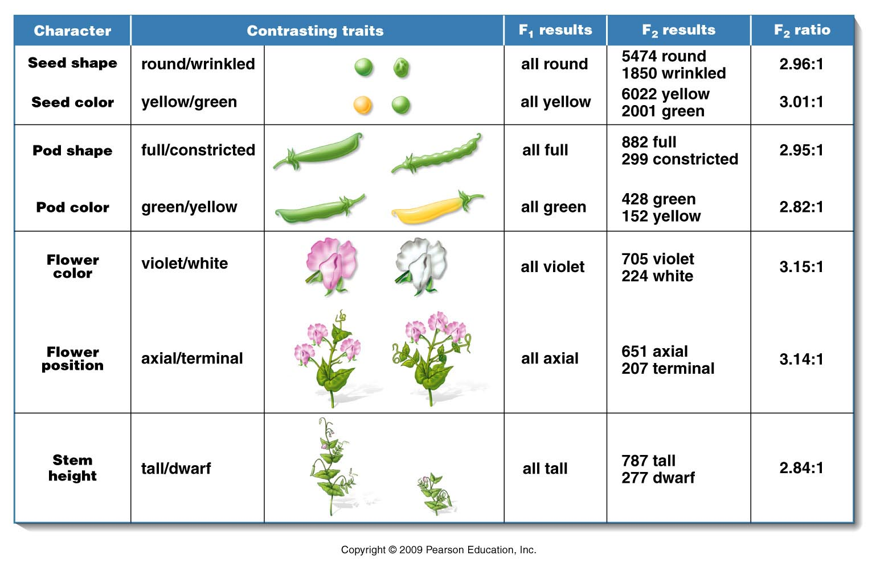
Mendel described 7 traits (phenotypes) of P. sativum which showed clear contrasting forms
Figure 3.1
Notes:
Figure 3-1 A summary of the seven pairs of contrasting traits and the results of Mendel’s seven monohybrid crosses of the garden pea (Pisum sativum). In each case, pollen derived from plants exhibiting one trait was used to fertilize the ova of plants exhibiting the other trait. In the F¹ generation, one of the two traits (dominant) was exhibited by all plants. The contrasting trait (recessive) then reappeared in approximately one-fourth of the F² plants.

Slide 33
Mendel’s experimental approach/terminology
On white board

Slide 34
Outcome of Mendel’s one-trait (monohybrid) crosses
Figure 3.1
Notes:
Figure 3-1 A summary of the seven pairs of contrasting traits and the results of Mendel’s seven monohybrid crosses of the garden pea (Pisum sativum). In each case, pollen derived from plants exhibiting one trait was used to fertilize the ova of plants exhibiting the other trait. In the F¹ generation, one of the two traits (dominant) was exhibited by all plants. The contrasting trait (recessive) then reappeared in approximately one-fourth of the F² plants.

Slide 35
Initial observations
(see table)
F1 generation had the phenotype of only one of the parents
F2 --the other parent’s phenotype showed up, but in only 1/4th of the offspring
Results of reciprocal crosses were identical (male X female)= (female X male)
*Mendel began to describe an inheritance particle that is passed from parents to offspring—unit factor

Slide 36
Principals/postulates derived from Mendel’s monohybrid crosses
Genetic traits/phenotypes are controlled by unit factors which exist in pairs in individual organisms.
When 2 unlike unit factors are present in an individual one is dominant to the other, which is called recessive.
During formation of gametes, the pairs of unit factors segregate randomly such that each gamete receives one or the other. (pairs of unit factors are restored in the union of gametes/production of offspring

Slide 37
What is a cross--really?
P X P or F1 X F1
----What is the “X”?
Plants (or whatever organism you study) having sex. The fertilization of eggs from female, with sperm from male.

Slide 38
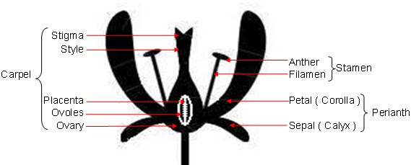
Many plants have both types of sexual equipment on one plant/flower. Self fertilization is the norm. That means, male and female gametes form using chromosomes from one genome combine to make the new generation.

